Slide 1
Fuzzy Clustering / Fuzzy C Means (FCM)/ Fuzzy K Means
Machine Learning
Group 6 (C181206 , C181208 , C181222)

Slide 2
Fuzzy c-means (FCM) is a method of clustering which allows one piece of data to belong to two or more clusters.
The unsupervised k-means clustering algorithm gives the values of any point lying in some particular cluster to be either as 0 or 1 i.e., either true or false.
But the fuzzy logic gives the fuzzy values of any particular data point to be lying in either of the clusters.
Here, in fuzzy c-means clustering, we find out the centroid of the data points and then calculate the distance of each data point from the given centroids until the clusters formed becomes constant.

Slide 3
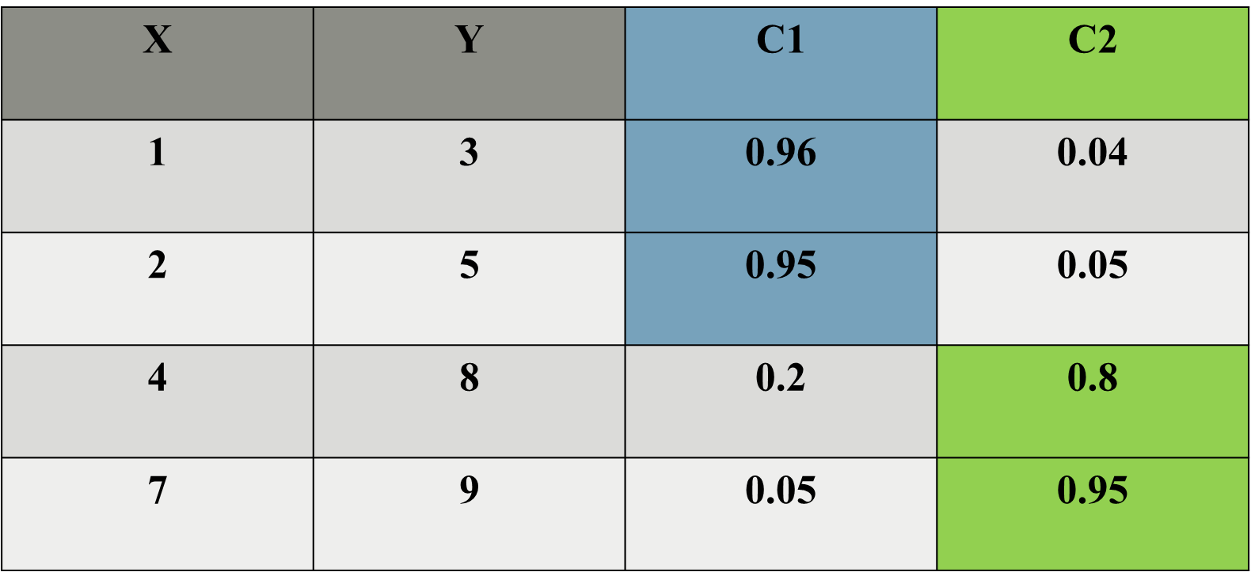
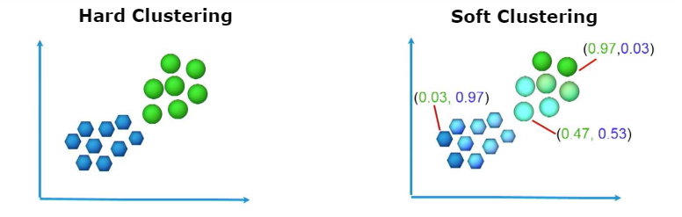
K Means Clustering
Fuzzy C Means
X | Y | C1 | C2
1 | 3 | 1 | 0
2 | 5 | 1 | 0
4 | 8 | 0 | 1
7 | 9 | 0 | 1

Slide 4
The steps to perform FCM algorithm are: Step 1: Initialize the data points into desired number of clusters randomly. Example : The given data points are {(1, 3), (2, 5), (4, 8), (7, 9)}
Let’s assume there are 2 clusters in which the data is to be divided, initializing the data point randomly. Each data point lies in both the clusters with some membership value which can be assumed anything in the initial state.
The table below represents the values of the data points along with their membership (gamma) in each of the cluster.
Cluster (1, 3) (2, 5) (4, 8) (7, 9)
1) 0.8 0.7 0.2 0.1
2) 0.2 0.3 0.8 0.9
X | Y | C1 | C2
1 | 3 | 0.8 | 0.2
2 | 5 | 0.7 | 0.3
4 | 8 | 0.2 | 0.8
7 | 9 | 0.1 | 0.9

Slide 5
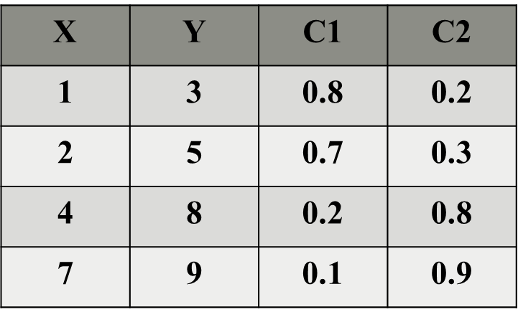
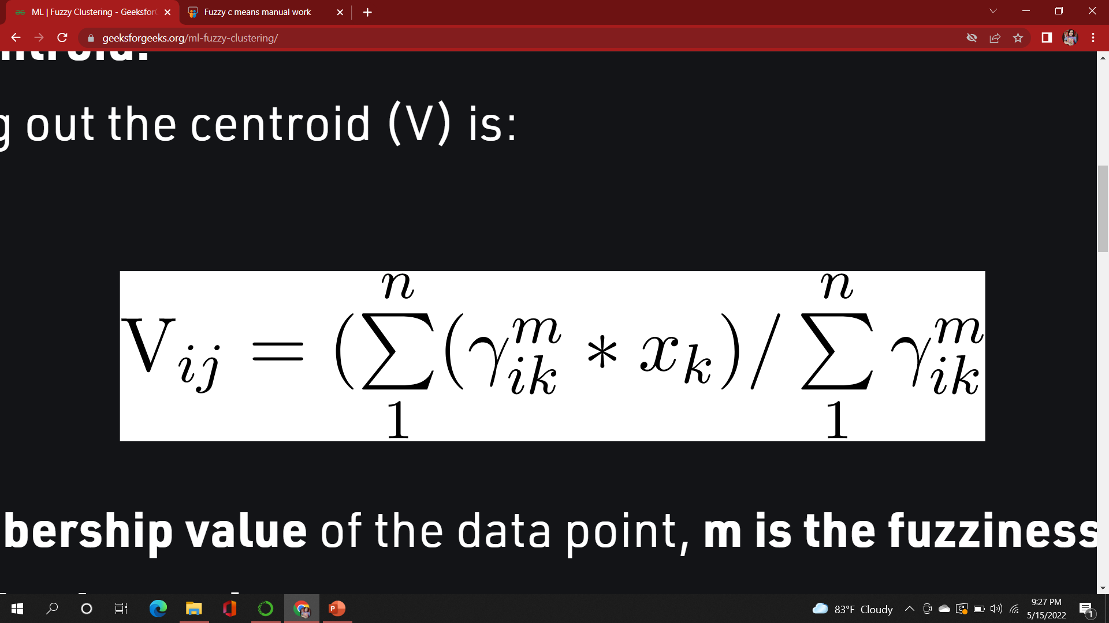
Step 2: Find out the centroid.
The formula for finding out the centroid (V) is:
Where, µ is fuzzy membership value of the data point, m is the fuzziness parameter (generally taken as 2), and xk is the data point. Here,
V11 = (0.8² *1 + 0.7² * 2 + 0.2² * 4 + 0.1² * 7) / ( (0.8² + 0.7² + 0.2² + 0.1² ) = 1.568
V12 = (0.8² *3 + 0.7² * 5 + 0.2² * 8 + 0.1² * 9) / ( (0.8² + 0.7² + 0.2² + 0.1² ) = 4.051
V21 = (0.2² *1 + 0.3² * 2 + 0.8² * 4 + 0.9² * 7) / ( (0.2² + 0.3² + 0.8² + 0.9² ) = 5.35
V22 = (0.2² *3 + 0.3² * 5 + 0.8² * 8 + 0.9² * 9) / ( (0.2² + 0.3² + 0.8² + 0.9² ) = 8.215
Centroids are: (1.568, 4.051) and (5.35, 8.215)

Slide 6
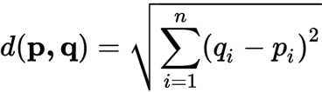
Step 3: Find out the distance of each point from centroid.
Data Points are: (1, 3) (2, 5) (4, 8) (7, 9)
Centroids are: (1.568, 4.051) and (5.35, 8.215)
D11 = ((1 - 1.568) ² + (3 - 4.051)²) ½ = 1.2
D12 = ((1 - 5.35) ² + (3 - 8.215) ²) ½ = 6.79
D21 = ((2 - 1.568) ² + (5 - 4.051) ²) ½ = 1.0427
D22 = ((2 - 5.35) ² + (5 - 8.215) ²) ½ = 4.643
D31 = ((4 - 1.568) ² + (8 - 4.051) ²) ½ = 4.637
D32 = ((4 - 5.35) ² + (8 - 8.215) ²) ½ = 1.367
D41 = ((7 - 1.568) ² + (9 - 4.051) ²) ½ = 7.348
D42 = ((7 - 5.35) ² + (9 - 8.215) ²) ½ = 1.827
Note: D31 means Distance from Datapoint 3 to cluster 1
Cluster 1 |  | Cluster 2
Data points | Distance | Data points | Distance
(1, 3) | 1.2 | (1, 3) | 6.79
(2, 5) | 1.0427 | (2, 5) | 4.643
(4, 8) | 4.637 | (4, 8) | 1.367
(7, 9) | 7.348 | (7, 9) | 1.827

Slide 7
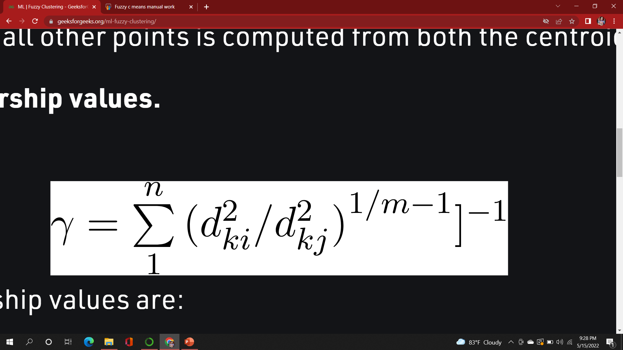
Step 4: Updating membership values.
Cluster 1 |  | Cluster 2
Data points | Distance | Data points | Distance
(1, 3) | 1.2 | (1, 3) | 6.79
(2, 5) | 1.0427 | (2, 5) | 4.643
(4, 8) | 4.637 | (4, 8) | 1.367
(7, 9) | 7.348 | (7, 9) | 1.827
For datapoint 1 new membership values are
ɣ11= [{ [(1.2)² / (1.2)²] + [(1.2)² / (6.79)²]} ^ {(1 / (2 – 1))} ] ⁻¹ = 0.97 (Cluster 1)
ɣ12=[{ [(6.79)² / (6.79)²] + [(6.79)² / (1.2)²]} ^ {(1 / (2 – 1))} ] ⁻¹ = 0.03 (Cluster 2)
Alternatively, 1-ɣ11 = ɣ12 = 0.04
Similarly, compute all other membership values, and update the matrix.
ɣ21= [{ [(1.0427)² / (1.0427)²] + [(1.0427)² / (4.643)²]} ^ {(1 / (2 – 1))} ] ⁻¹ =0.95 (Cluster 1)
ɣ22=[{ [(4.643)² / (4.643)²] + [(4.643)² / (1.0427)²]} ^ {(1 / (2 – 1))} ] ⁻¹ = 0.05 (Cluster 2)
ɣ31= [{ [(4.637)² / (4.637)²] + [(4.637)² / (1.367)²]} ^ {(1 / (2 – 1))} ] ⁻¹ = 0.08 (Cluster 1)
ɣ32=[{ [(1.367 ² / (1.367)²] + [(1.367)² / (4.637)²]} ^ {(1 / (2 – 1))} ] ⁻¹ = 0.92 (Cluster 2)
ɣ41= [{ [(7.348)² / (7.348)²] + [(7.348)² / (1.827)²]} ^ {(1 / (2 – 1))} ] ⁻¹ = 0.05 (Cluster 1)
ɣ42=[{ [(1.827)² / (1.827)²] + [(1.827)² / (7.348)²]} ^ {(1 / (2 – 1))} ] ⁻¹ = 0.95 (Cluster 2)

Slide 8
Now the new membership value is
X | Y | Cluster 1 | Cluster 2
1 | 3 | 0.97 | 0.03
2 | 5 | 0.95 | 0.05
4 | 8 | 0.08 | 0.92
7 | 9 | 0.06 | 0.94

Slide 9
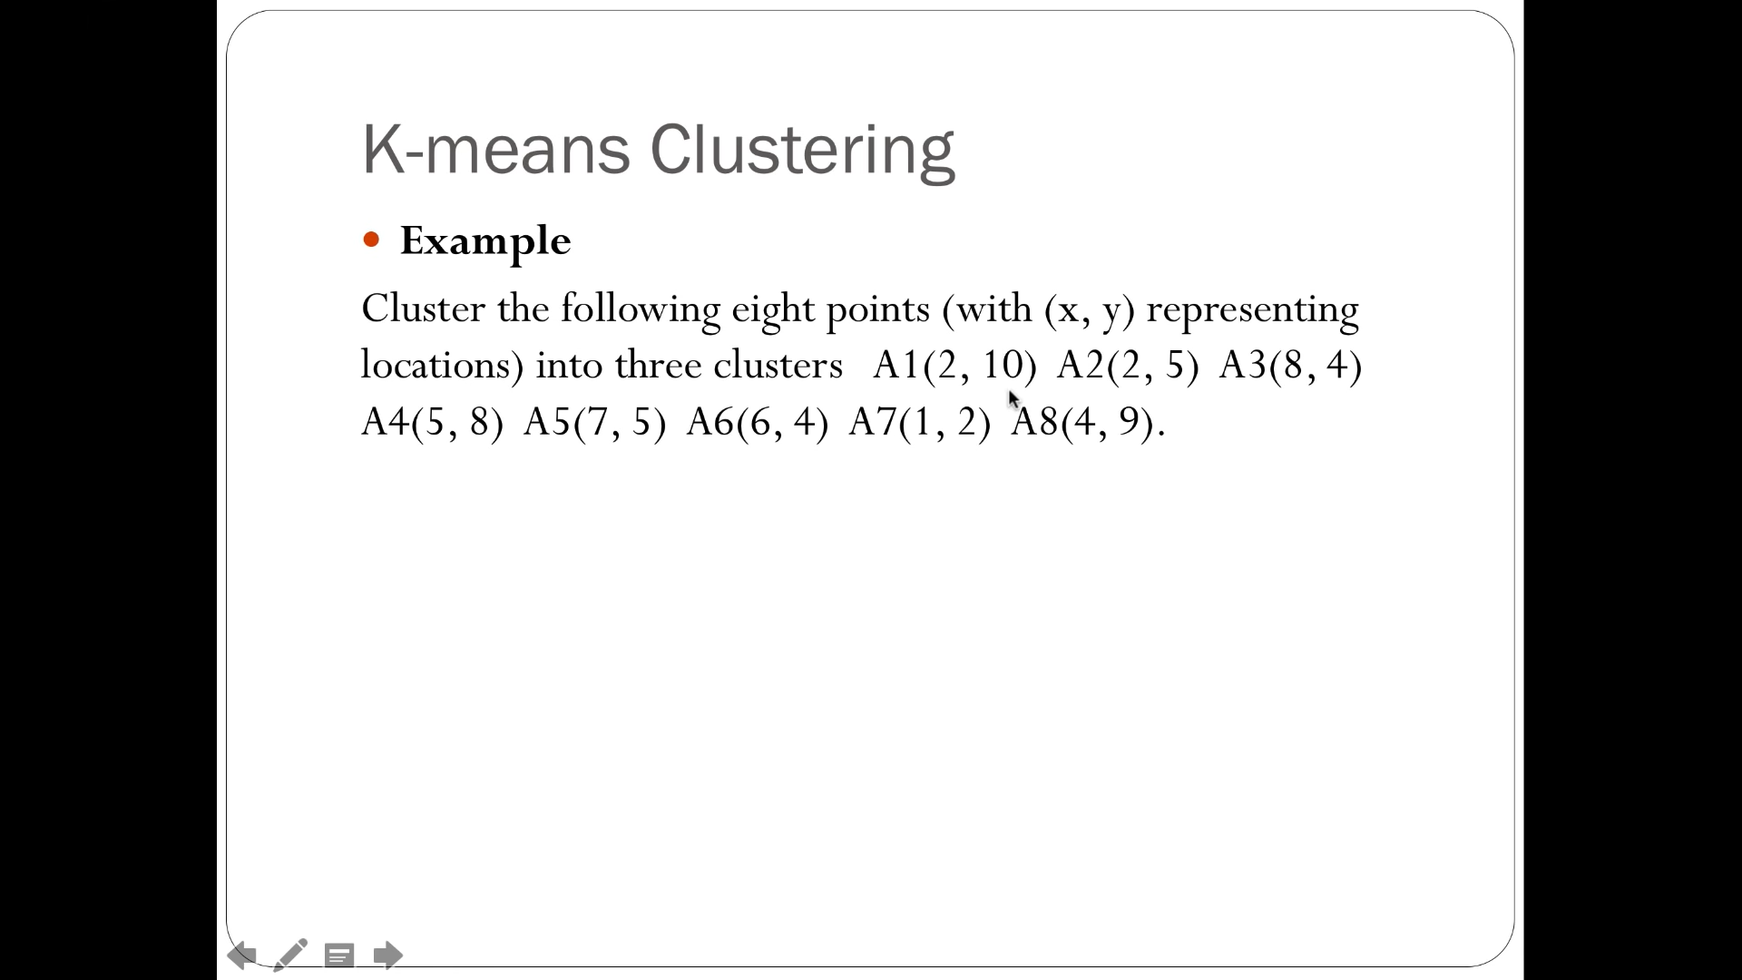
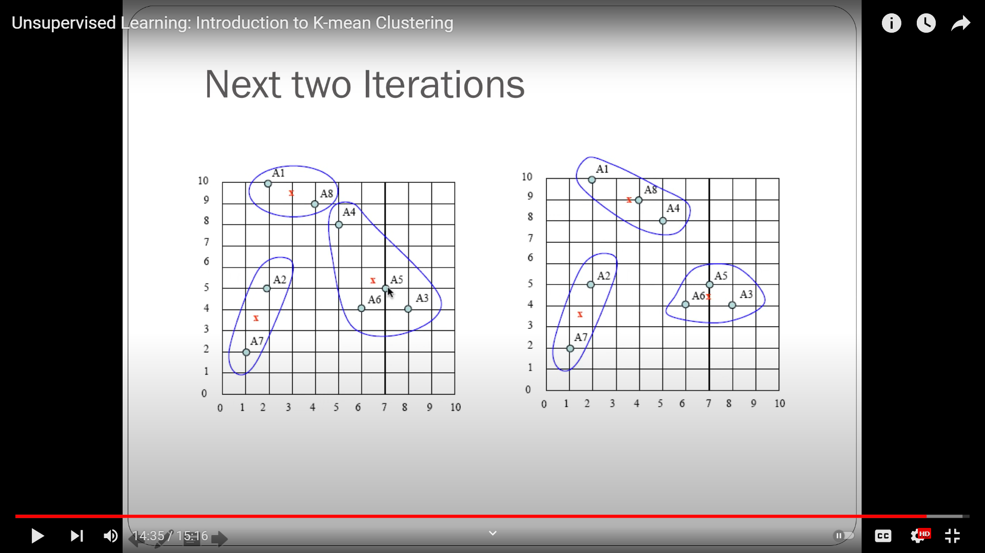
Below we can see a k means clustering example that will be moderate later using fuzzy c means algorithm in next slides
 | Datapoint | Cluster 1 | Cluster 2 | Cluster 3
A1 | (2,10) | 1 | 0 | 0
A2 | (2,5) | 0 | 0 | 1
A3 | (8,4) | 0 | 1 | 0
A4 | (5,8) | 1 | 0 | 0
A5 | (7,5) | 0 | 1 | 0
A6 | (6,4) | 0 | 1 | 0
A7 | (1,2) | 0 | 0 | 1
A8 | (4,9) | 1 | 0 | 0

Slide 10
The steps to perform FCM algorithm are: Step 1: Initialize the data points into desired number of clusters randomly. Example : The given data points are {(2,10), (2,5), (8,4), (5, 8), (7,5), (6,4), (1,2), (4,9)}
There are 3 clusters in which the data is to be divided, initializing the data point randomly. Each data point lies in both the clusters with some membership value which can be assumed anything in the initial state.
The table represents the values of the data points along with their membership (gamma) in each of the cluster.
 | Datapoint | Cluster 1 | Cluster 2 | Cluster 3
A1 | (2,10) | 1 | 0 | 0
A2 | (2,5) | 0 | 0 | 1
A3 | (8,4) | 0 | 1 | 0
A4 | (5,8) | 1 | 0 | 0
A5 | (7,5) | 0 | 1 | 0
A6 | (6,4) | 0 | 1 | 0
A7 | (1,2) | 0 | 0 | 1
A8 | (4,9) | 1 | 0 | 0

Slide 11
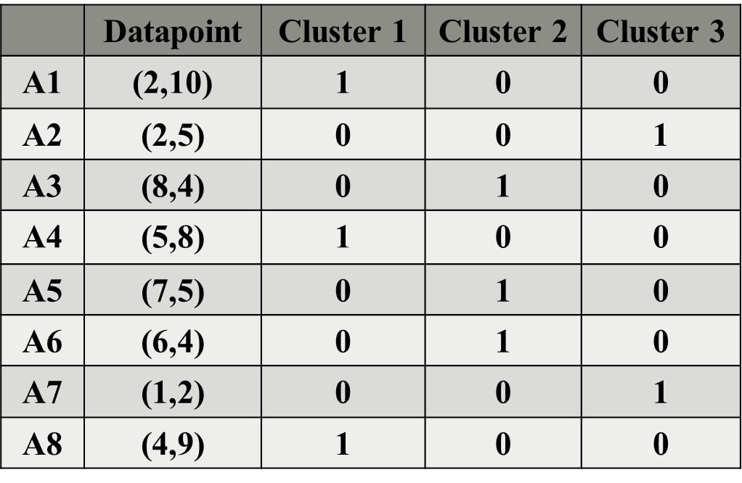
Step 2: Find out the centroid.
The formula for finding out the centroid (V) is:
Where, µ is fuzzy membership value of the data point, m is the fuzziness parameter (generally taken as 2), and xk is the data point. Here,
Centroid of cluster 1:
V11 = (1² *2 + 0² * 2 + 0² * 8 + 1² * 5 + 0² *7 + 0² * 6 + 0² * 1 + 1² * 4) / ( (1² + 0² + 0² + 1² + 0² + 0² + 0² + 1² ) = 3.67
V12 = (1² *10 + 1² * 8 + 1² * 9) / ( (1² +1² +1² ) = 9
So , the Centroid of cluster 1 is ( 3.67 , 9 )

Slide 12
Centroid of cluster 2:
V21 = (1² *8 + 1² * 7 + 1² * 6) / ( (1² +1² +1² ) = 7
V22 = (1² *4 + 1² * 5 + 1² * 4) / ( (1² +1² +1² ) = 4.33
So , the Centroid of cluster 1 is ( 7 , 4.33 )
Centroid of cluster 3:
(1² *2 + 1² * 1) / ( ( 1² +1² ) = 1.5
V32 = (1² *5 + 1² * 2) / ( (1² +1²) = 3.5
So , the Centroid of cluster 1 is ( 1.5, 3.5 )

Slide 13
Step 3: Find out the distance of each point from centroid.
Data Points are: {(2,10), (2,5), (8,4), (5, 8), (7,5), (6,4), (1,2), (4,9)} Centroids are: ( 3.67 , 9 ) , ( 7 , 4.33 ) and ( 1.5 , 3.5 )
Note: D83 means Distance from Datapoint 8 to cluster 3
D11 | ((2 – 3.67) ² + (10 - 9)²) ½ | 1.9465
D12 | ((2 – 7) ² + (10 - 4.33)²) ½ | 7.5596
D13 | ((2 – 1) ² + (10 - 3.5)²) ½ | 6.52
D21 | ((2 – 3.67) ² + (5 - 9)²) ½ | 4.3346
D22 | ((2 – 7) ² + (5 - 4.33)²) ½ | 5.0447
D23 | ((2 – 1) ² + (5 - 3.5)²) ½ | 1.581
D31 | ((8 – 3.67) ² + (4 - 9)²) ½ | 6.6143
D32 | ((8 – 7) ² + (4 - 4.33)²) ½ | 1.053
D33 | ((8 – 1) ² + (4 - 3.5)²) ½ | 6.52
D41 | ((5 – 3.67) ² + (8 - 9)²) ½ | 1.664
D42 | ((5 – 7) ² + (8 - 4.33)²) ½ | 4.1795
D43 | ((5 – 1) ² + (8 - 3.5)²) ½ | 5.70
D51 | ((7 – 3.67) ² + (5 - 9)²) ½ | 5.2047
D52 | ((7 – 7) ² + (5 - 4.33)²) ½ | 0.67
D53 | ((7 – 1) ² + (5 - 3.5)²) ½ | 5.70
D61 | ((6 – 3.67) ² + (4 - 9)²) ½ | 5.5162
D62 | ((6 – 7) ² + (4 - 4.33)²) ½ | 1.053
D63 | ((6 – 1) ² + (4 - 3.5)²) ½ | 4.528
D71 | ((1 – 3.67) ² + (2- 9)²) ½ | 7.4919
D72 | ((1 – 7) ² + (2 - 4.33)²) ½ | 6.4365
D73 | ((1 – 1) ² + (2 - 3.5)²) ½ | 1.58
D81 | ((4 – 3.67) ² + (9- 9)²) ½ | 0.33
D82 | ((4 – 7) ² + (9 - 4.33)²) ½ | 5.55
D83 | ((4 – 1) ² + (9 - 3.5)²) ½ | 6.042

Slide 14
Distance of each point from centroid of each cluster
 | Cluster 1 |  | Cluster 2 |  | Cluster 3
 | Datapoint | Distance | Datapoint | Distance | Datapoint | Distance
A1 | (2,10) | 1.9465 | (2,10) | 7.559 | (2,10) | 6.52
A2 | (2,5) | 4.3346 | (2,5) | 5.0447 | (2,5) | 1.581
A3 | (8,4) | 6.6143 | (8,4) | 1.053 | (8,4) | 6.52
A4 | (5,8) | 1.664 | (5,8) | 4.1795 | (5,8) | 5.70
A5 | (7,5) | 5.2 | (7,5) | 0.67 | (7,5) | 5.70
A6 | (6,4) | 5.5162 | (6,4) | 1.053 | (6,4) | 4.528
A7 | (1,2) | 7.49 | (1,2) | 6.43 | (1,2) | 1.58
A8 | (4,9) | 0.33 | (4,9) | 5.55 | (4,9) | 6.042

Slide 15
Step 4: Updating membership values.
Cluster 1 |  | Cluster 2 |  | Cluster 3
Data point | Distance | Data point | Distance | Datapoint | Distance
(2,10) | 1.9465 | (2,10) | 7.559 | (2,10) | 6.52
(2,5) | 4.3346 | (2,5) | 5.0447 | (2,5) | 1.581
For datapoint 1 ,new membership values are
ɣ11= [{ [(1.9465)² / (1.9465)²] + [(1.9465)² / (7.9956)²] + [(1.9465)² / (6.576)² ]} ^ {(1 / (2 – 1))} ] ⁻¹ = 0.87 (Cluster 1)
ɣ12= [{ [(7.9956)² / (7.9956)²] + [(7.9956)² / (1.9465)²] + [(7.9956)² / (6.576)² ]} ^ {(1 / (2 – 1))} ] ⁻¹ = 0.06 (Cluster 2)
ɣ13= [{ [(6.576)² / (6.576)²] + [(6.576)² / (7.9956)²] + [(6.576)² / (1.9465)² ]} ^ {(1 / (2 – 1))} ] ⁻¹ = 0.077 (Cluster 3)
Alternatively, ɣ13= 1 - ɣ11 - ɣ12 = 0.08
Similarly, compute all other membership values, and update the matrix.
For datapoint 2 ,new membership values are
ɣ21= [{ [(4.3346)² / (4.3346)²] + [(4.3346)² / (5.0447)²] + [(4.3346)² / (1.8027)² ]} ^ {(1 / (2 – 1))} ]⁻¹ = 0.1 (Cluster 1)
ɣ22= [{ [(5.0447)² / (5.0447)²] + [(5.0447)² / (4.3346)²] + [(5.0447)² / (1.8027)² ]} ^ {(1 / (2 – 1))} ] ⁻¹= 0.08 (Cluster 2)
ɣ23= [{ [(1.8027)² / (1.8027)²] + [(1.8027)² / (4.3346)²] + [(1.8027)² / (5.0447)² ]} ^ {(1 / (2 – 1))} ]⁻¹ = 0.82 (Cluster 3)

Slide 16
 | Cluster 1 |  | Cluster 2 |  | Cluster 3
 | Data point | Distance | Datapoint | Distance | Data point | Distance
A3 | (8,4) | 6.6143 | (8,4) | 1.053 | (8,4) | 6.52
A4 | (5,8) | 1.664 | (5,8) | 4.1795 | (5,8) | 5.70
A5 | (7,5) | 5.2 | (7,5) | 0.67 | (7,5) | 5.70
For datapoint 3 ,new membership values are
ɣ31= [{ [(6.6143)² / (6.6143)²] + [(6.6143)² / (1.053)²] + [(6.6143)² / (7.0178)² ]} ^ {(1 / (2 – 1))} ] ⁻¹ = 0.024 (Cluster 1)
ɣ32= [{ [(1.053)² / (1.053)²] + [(1.053)² / (6.6143)²] + [(1.053)² / (7.0178)² ]} ^ {(1 / (2 – 1))} ] ⁻¹ = 0.95 (Cluster 2)
ɣ33= [{ [(7.0178)² / (7.0178)²] + [(7.0178)² / (6.6143)²] + [(7.0178)² / (1.053)² ]} ^ {(1 / (2 – 1))} ] ⁻¹ = 0.025 (Cluster 3)
For datapoint 4 ,new membership values are
ɣ41= [{ [(1.664)² / (1.664)²] + [(1.664)² / (4.1795)²] + [(1.664)² / (6.02)² ]} ^ {(1 / (2 – 1))} ] ⁻¹ = 0.8 (Cluster 1)
ɣ42= [{ [(4.1795)² / (4.1795)²] + [(4.1795)² / (1.664)²] + [(4.1795)² / (6.02)² ]} ^ {(1 / (2 – 1))} ] ⁻¹ = 0.13 (Cluster 2)
ɣ43= [{ [(6.02)² / (6.02)²] + [(6.02)² / (4.1795)²] + [(6.02)² / (1.664)² ]} ^ {(1 / (2 – 1))} ] ⁻¹ = 0.06 (Cluster 3)
For datapoint 5 ,new membership values are
ɣ51= [{ [(5.2)² / (5.2)²] + [(5.2)² / (0.67)²] + [(5.2)² / (6.184)² ]} ^ {(1 / (2 – 1))} ] ⁻¹ = 0.02 (Cluster 1)
ɣ52= [{ [(0.67)² / (0.67)²] + [(0.67)² / (5.2)²] + [(0.67)² / (6.184)² ]} ^ {(1 / (2 – 1))} ] ⁻¹ = 0.97 (Cluster 2)
ɣ53= [{ [(6.184)² / (6.184)²] + [(6.184)² / (5.2)²] + [(6.184)² / (0.67)² ]} ^ {(1 / (2 – 1))} ] ⁻¹ = 0.01 (Cluster 3)

Slide 17
 | Cluster 1 |  | Cluster 2 |  | Cluster 3
 | Data point | Distance | Data point | Distance | Data point | Distance
A6 | (6,4) | 5.5162 | (6,4) | 1.053 | (6,4) | 4.528
A7 | (1,2) | 7.49 | (1,2) | 6.43 | (1,2) | 1.58
A8 | (4,9) | 0.33 | (4,9) | 5.55 | (4,9) | 6.042
For datapoint 6 ,new membership values are
ɣ31= [{ [(5.5162)² / (5.5162)²] + [(5.5162)² / (1.053)²] + [(5.5162)² / (5.02)² ]} ^ {(1 / (2 – 1))} ] ⁻¹ = 0.03 (Cluster 1)
ɣ32= [{ [(1.053)² / (1.053)²] + [(1.053)² / (5.5162)²] + [(1.053)² / (5.02)² ]} ^ {(1 / (2 – 1))} ] ⁻¹ = 0.92 (Cluster 2)
ɣ33= [{ [(5.02)² / (5.02)²] + [(5.02)² / (5.5162)²] + [(5.02)² / (1.053)² ]} ^ {(1 / (2 – 1))} ] ⁻¹ = 0.05 (Cluster 3)
For datapoint 7 ,new membership values are
ɣ41= [{ [(7.49)² / (7.49)²] + [(7.49)² / (6.43)²] + [(7.49)² / (1.5)² ]} ^ {(1 / (2 – 1))} ] ⁻¹ = 0.04 (Cluster 1)
ɣ42= [{ [(6.43)² / (6.43)²] + [(6.43)² / (7.49)²] + [(6.43)² / (1.5)² ]} ^ {(1 / (2 – 1))} ] ⁻¹ = 0.05 (Cluster 2)
ɣ43= [{ [(1.5)² / (1.5)²] + [(1.5)² / (6.43)²] + [(1.5)² / (7.49)² ]} ^ {(1 / (2 – 1))} ] ⁻¹ = 0.9 (Cluster 3)
For datapoint 8 ,new membership values are
ɣ51= [{ [(0.33)² / (0.33)²] + [(0.33)² / (5.55)²] + [(0.33)² / (6.26)² ]} ^ {(1 / (2 – 1))} ] ⁻¹ = 0.993 (Cluster 1)
ɣ52= [{ [(5.55)² / (5.55)²] + [(5.55)² / (0.33)²] + [(5.55)² / (6.26)² ]} ^ {(1 / (2 – 1))} ] ⁻¹ = 0.003 (Cluster 2)
ɣ53= [{ [(6.26)² / (6.26)²] + [(6.26)² / (0.33)²] + [(6.26)² / (5.55)² ]} ^ {(1 / (2 – 1))} ] ⁻¹ = 0.003 (Cluster 3)

Slide 18
Now the new membership value is
 | Datapoint | X | Y | Cluster 1 | Cluster 2 | Cluster 3
A1 | (2,10) | 2 | 10 | 0.86 | 0.057 | 0.07
A2 | (2,5) | 2 | 5 | 0.108 | 0.08 | 0.8
A3 | (8,4) | 8 | 4 | 0.025 | 0.95 | 0.025
A4 | (5,8) | 5 | 8 | 0.81 | 0.13 | 0.06
A5 | (7,5) | 7 | 5 | 0.02 | 0.97 | 0.01
A6 | (6,4) | 6 | 4 | 0.03 | 0.92 | 0.05
A7 | (1,2) | 1 | 2 | 0.04 | 0.055 | 0.91
A8 | (4,9) | 4 | 9 | 0.99 | 0.003 | 0.003

Slide 19
The steps to perform FCM algorithm in Iris Dataset are: Step 1: Initialize the data points into desired number of clusters randomly. Example : The given data points are {(5,1,3.5),(1.4,0.2); (4.9,3.0), (1.4,0.2); (6.4,3.2), (4.5,1.5); (6.9,3.1),(4.9,1.5); (6.2,3.4), (5.4,2.3); (5.9,3.0),(5.1,1.8)}
There are 3 clusters in which the data is to be divided, initializing the data point randomly. Each data point lies in both the clusters with some membership value which can be assumed anything in the initial state.
The table represents the values of the data points along with their membership (gamma) in each of the cluster.
ID | Datapoint | Setosa | Versicolor | Verginica
1 | (5,1,3.5), (1.4,0.2) | 1 | 0 | 0
2 | (4.9,3.0), (1.4,0.2) | 1 | 0 | 0
52 | (6.4,3.2), (4.5,1.5) | 0 | 1 | 0
53 | (6.9,3.1), (4.9,1.5) | 0 | 1 | 0
149 | (6.2,3.4), (5.4,2.3) | 0 | 0 | 1
150 | (5.9,3.0), (5.1,1.8) | 0 | 0 | 1

Slide 20
Step 2: Find out the centroid.
The formula for finding out the centroid (V) is:
Where, µ is fuzzy membership value of the data point, m is the fuzziness parameter (generally taken as 2), and xk is the data point. Here,
Centroid of Setosa(cluster 1):
V11 = (1² *5.1 + + 1² * 1.4 + 1² * 4.9 + 1² * 1.4) /(1² + 1² ) = 6.4
V12 = (1² *3.5 + 1² * 0.2 + 1² * 3.0+ 1² * 0.2) /( (1² +1²) = 3.45
So , the Centroid of Setosa is (6.4 , 3.45 ).

Slide 21
Centroid of Versicolor(cluster 2):
V21 = (1² *6.4 + 1² * 4.5+ 1² * 6.9 + 1² * 4.9) / ( (1² +1² ) = 11.35
V22 = (1² *3.2 + 1² * 1.5 + 1² * 3.1 +1² * 1.5 ) / ( (1² +1² ) = 4.65
So , the Centroid of Versicolor is ( 11.35, 4.65 ).
Centroid of Verginica(cluster 3):
V31= (1² *6.2 + 1² * 5.4 + 1² * 5.9+ 1² * 5.1) / ( ( 1² +1² ) = 11.3
V32 = (1² *3.4 + 1² * 2.3+ 1² * 3.0 + 1² * 1.8) / ( (1² +1²) = 5.25
So , the Centroid of Verginica is ( 11.3, 5.25 ).

Slide 22
Step 3: Find out the distance of each point from centroid.
Note: D33 means Distance from Datapoint 3 to cluster 3
Data Points are: {(5,1,3.5),(1.4,0.2); (4.9,3.0),(1.4,0.2); (6.4,3.2),(4.5,1.5); (6.9,3.1),(4.9,1.5); (6.2,3.4),(5.4,2.3); (5.9,3.0),(5.1,1.8)}
Centroids are: (6.4 , 3.45 ), (11.35,4.65) and (11.3,5.25) .
D11 | ((5.1 – 6.4) ²+(1.4 – 6.4) ²+(3.5 – 3.45) ² +(0.2 – 3.45) ²) ½ | 0.180
D12 | ((5.1 – 11.35) ²+(1.4 – 11.35) ²+(3.5 – 4.65) ² +(0.2– 4.65) ²) ½ | 1.627
D13 | ((5.1 – 11.3) ²+(1.4 –11.3) ²+(3.5 – 5.25) ² +(0.2– 5.25) ²) ½ | 2.66
D21 | ((4.9 – 6.4) ²+(1.4 – 6.4) ²+(3.0 – 3.45) ² +(0.2 – 3.45) ²) ½ | 0.57
D22 | ((4.9 – 11.35) ²+(1.4 – 11.35) ²+(3.0 – 4.65) ² +(0.2 – 4.65) ²) ½ | 1.811
D23 | ((4.9 – 11.3) ²+(1.4 –11.3) ²+(3.0 – 5.25) ² +(0.2– 5.25) ²) ½ | 2.404
D31 | ((6.4– 6.4) ²+(4.5 – 6.4) ²+(3.2 – 3.45) ² +(1.5 – 3.45) ²) ½ | 1.769
D32 | ((6.4– 11.35) ²+(4.5– 11.35) ²+(3.2 – 4.65) ² +(1.5 – 4.65) ²) ½ | 0.3
D33 | ((6.4– 11.3) ²+(4.5–11.3) ²+(3.2– 5.25) ² +(1.5 – 5.25) ²) ½ | 1.769

Slide 23
Note: D63 means Distance from Datapoint 6 to cluster 3
Data Points are: {(5,1,3.5),(1.4,0.2); (4.9,3.0),(1.4,0.2); (6.4,3.2),(4.5,1.5); (6.9,3.1),(4.9,1.5); (6.2,3.4),(5.4,2.3); (5.9,3.0),(5.1,1.8)}
Centroids are: (6.4 , 3.45 ), (11.35,4.65) and (11.3,5.25) .
D41 | ((6.9– 6.4) ²+(4.9 – 6.4) ²+(3.1 – 3.45) ² +(1.5 – 3.45) ²) ½ | 5.2
D42 | ((6.9– 11.35) ²+(4.9– 11.35) ²+(3.1– 4.65) ² +(1.5– 4.65)²)½ | 0.67
D43 | ((6.9– 11.3) ²+(4.9–11.3) ²+(3.1– 5.25) ² +(1.5– 5.25) ²) ½ | 6.184
D51 | ((6.2 – 6.4) ²+(5.4 – 6.4) ²+(3.4 – 3.45) ² +(2.3 – 3.45) ²) ½ | 7.49
D52 | ((6.2– 11.35) ²+(5.4– 11.35) ²+(3.4– 4.65) ² +(2.3– 4.65)²)½ | 6.43
D53 | ((6.2– 11.3) ²+(5.4–11.3) ²+(3.4– 5.25) ² +(2.3– 5.25) ²) ½ | 1.5
D61 | ((5.9 – 6.4) ²+(5.1– 6.4) ²+(3.0 – 3.45) ² +(1.8 – 3.45) ²) ½ | 0.33
D62 | ((5.9– 11.35) ²+(5.1– 11.35) ²+(3.0– 4.65) ² +(1.8– 4.65)²)½ | 5.55
D63 | ((5.9– 11.3) ²+(5.1–11.3) ²+(3.0– 5.25) ² +(1.8– 5.25) ²) ½ | 6.26

Slide 24
Distance of each point from centroid of each cluster
 | Setosa |  | Versicolor | Verginica
ID | Datapoint | Distance | Distance | Distance
1 | (5,1,3.5),(1.4,0.2) | 0.180 | 1.627 | 2.66
2 | (4.9,3.0),(1.4,0.2) | 0.57 | 1.811 | 2.404
52 | (6.4,3.2),(4.5,1.5) | 1.769 | 0.3 | 1.769
53 | (6.9,3.1),(4.9,1.5) | 5.2 | 0.67 | 6.184
149 | (6.2,3.4),(5.4,2.3) | 7.49 | 6.43 | 1.5
150 | (5.9,3.0),(5.1,1.8) | 0.33 | 5.55 | 6.26

Slide 25
Step 4: Updating membership values.
Setosa |  | Versicolor | Verginica
Data point | Distance | Distance | Distance
(5,1,3.5), (1.4,0.2) | 0.180 | 1.672 | 2.66
(4.9,3.0), (1.4,0.2) | 0.57 | 1.811 | 2.404
For datapoint 1 ,new membership values are
ɣ11=[{[(0.180)²/(0.180)²]+[(0.180)²/(1.672)²]+[(0.180)²/(2.66)² ]}^{(1 / (2 – 1))}]⁻¹= 0.90 (Setosa)
ɣ12=[{[(1.672)²/(1.672)²]+[(1.672)²/(0.180)²]+[(1.672)²/(2.66)² ]}^{(1 / (2 – 1))}]⁻¹= 0.069(Versicolor)
ɣ13=[{[(2.66)²/(2.66)²]+[(2.66)²/(1.672)²] + [(2.66)² / (0.180)² ]}^{(1 / (2 – 1))}]⁻¹= 0.04(Virginica)
Similarly, compute all other membership values, and update the matrix.
For datapoint 2 ,new membership values are
ɣ21=[{[(0.57)²/(0.57)²]+[(0.57)²/(1.811)²]+[(0.57)²/(2.404)² ]}^{(1 / (2 – 1))}]⁻¹= 0.80(Setosa)
ɣ22=[{[(1.811)²/(1.811)²]+[(1.811)²/(0.57)²]+[(1.811)²/(2.404)² ]}^{(1 / (2 – 1))}]⁻¹= 0.11(Versicolor)
ɣ23=[{[(2.404)²/(2.404)²]+[(2.404)²/(1.811)²] + [(2.404)² / (0.57)² ]}^{(1 / (2 – 1))}]⁻¹= 0.08(Virginica)

Slide 26
Setosa |  | Versicolor | Verginica
Data point | Distance | Distance | Distance
(6.4,3.2),(4.5,1.5) | 1.769 | 0.3 | 1.769
(6.9,3.1),(4.9,1.5) | 5.2 | 0.67 | 6.184
For datapoint 3, new membership values are
ɣ31=[{[(1.769)²/(1.769)²]+[(1.769)²/(0.3)²]+[(1.769)²/(1.769)² ]}^{(1 / (2 – 1))}]⁻¹= 0.09(Setosa)
ɣ32=[{[(0.3)²/(0.3)²]+[(0.3)²/(1.769)²]+[(0.3)²/(1.769)² ]}^{(1 / (2 – 1))}]⁻¹= 0.68(Versicolor)
ɣ33=[{[(1.769)²/(1.769)²]+[(1.769)²/(0.3)²] + [(1.769)² / (1.769)² ]}^{(1 / (2 – 1))}]⁻¹= 0.27(Virginica)
For datapoint 4, new membership values are
ɣ41=[{[(5.2)²/(5.2)²]+[(5.2)²/(0.67)²]+[(5.2)²/(6.184)² ]}^{(1 / (2 – 1))}]⁻¹= 0.09(Setosa)
ɣ42=[{[(0.67)²/(0.67)²]+[(0.67)²/(5.2)²]+[(0.67)²/(6.184)² ]}^{(1 / (2 – 1))}]⁻¹= 0.63(Versicolor)
ɣ43=[{[(6.184)²/(6.184)²]+[(6.184)²/(0.67)²] + [(6.184)² / (5.2)² ]}^{(1 / (2 – 1))}]⁻¹= 0.27(Virginica)

Slide 27
Setosa |  | Versicolor | Verginica
Data point | Distance | Distance | Distance
(6.2,3.4), (5.4,2.3) | 7.49 | 6.43 | 1.5
(5.9,3.0), (5.1,1.8) | 0.33 | 5.55 | 6.26
For datapoint 5, new membership values are
ɣ51=[{[(7.49)²/(7.49)²]+[(7.49)²/(6.43)²]+[(7.49)²/(1.5)² ]}^{(1 / (2 – 1))}]⁻¹= 0.09(Setosa)
ɣ52=[{[(6.43)²/(6.43)²]+[(6.43)²/(7.49)²]+[(6.43)²/(1.5)² ]}^{(1 / (2 – 1))}]⁻¹= 0.30(Versicolor)
ɣ53=[{[(1.5)²/(1.5)²]+[(1.5)²/(6.43)²]+[(1.5)² /(7.49)² ]}^{(1 / (2 – 1))}]⁻¹= 0.60 (Virginica)
For datapoint 6, new membership values are
ɣ61=[{[(0.33)²/(0.33)²]+[(0.33)²/(5.55)²]+[(0.33)²/(6.26)² ]}^{(1 / (2 – 1))}]⁻¹= 0.07(Setosa)
ɣ62=[{[(5.55)²/(5.55)²]+[(5.55)²/(0.33)²]+[(5.55)²/(6.26)² ]}^{(1 / (2 – 1))}]⁻¹= 0.40(Versicolor)
ɣ63=[{[(6.26)²/(6.26)²]+[(6.26)²/(5.55)²]+[(6.26)² / (0.33)² ]}^{(1 / (2 – 1))}]⁻¹= 0.51(Virginica)

Slide 28
Now the new membership value is:
ID | Datapoint | X | Y | Setosa | Versicolor | Verginica
1 | (5.1,3.5), (1.4,0.2) | (5.1,1.4) | (3.5,0.2) | 0.90 | 0.06 | 0.04
2 | (4.9,3.0), (1.4,0.2) | (4.9, 1.4) | (3.0,0.2) | 0.8 | 0.11 | 0.08
52 | (6.4,3.2), (4.5,1.5) | (6.4, 4.5) | (3.2,1.5) | 0.09 | 0.68 | 0.27
53 | (5.9,3.0), (5.1,1.8) | (5.9, 5.1) | (3.0,1.8) | 0.09 | 0.63 | 0.27
149 | (6.2,3.4), (5.4,2.3) | (6.2, 5.4) | (3.4,2.3) | 0.09 | 0.30 | 0.60
150 | (5.9,3.0), (5.1,1.8) | (5.9, 5.1) | (3.0,1.8) | 0.07 | 0.40 | 0.51

